Slide 1
Classify and Predict Injury Severity Using Crash Reporting Sampling System (CRSS) Data of the Most Recent Years
Instructor:
Prof.Fred Feng
Team 16:
Meghanath Payasam
Golnoosh Garakani
Ayegba David Haruna

Slide 2
Outline
Background and Research Questions
Methodology of Research
Data Description and Engineering
Visualization
Modeling
Results (e.g., data analysis, modeling results, etc.)
Conclusions

Slide 3
Outline
Background and Research Questions
Methodology of Research
Data Description and Engineering
Visualization
Modeling
Results (e.g., data analysis, modeling results, etc.)
Conclusions

Slide 4
Background and Research Questions
Road traffic accidents are a widespread problem, resulting in many injuries and deaths worldwide.
In the US, in 2022, car crashes resulted in 42,795 deaths, incurring costs of over $300 billion.
Literature Gap
Recent years’ trend and changes in the pattern of the crashes
Objective
Identify the trend of leading factors to crash severity
Research questions to achieve the study objectives:
Which factors contributed to severe injury or fatality in recent years?
Which factors contributed to minor or no injury in recent years?
How did changes in leading factors influence the injury severity over the years?
Which modeling scheme can more accurately represent the statistical property of the data and precisely predict the injury severity?

Slide 5
Outline
Background and Research Questions
Methodology of Research
Data Description and Engineering
Visualization
Modeling
Results (e.g., data analysis, modeling results, etc.)
Conclusions

Slide 6
Research Methodology
Employed recent accident data from the CRSS from 2019-2021.
Data set creation and data engineering to prepare the data set for modeling.
Categorized the severity of accidents into two groups
Major injury/Fatal as label 1.
No injury/Minor injury as label 0
Considered various factors including the year, geographic region, month, weekday, speed, alcohol involvement, weather conditions, age group, use of restraints, and driver distraction.
Conducted Feature correlation analysis to gain insights into the data elements
Statistical modeling using binary classification methods of Logistic Regression and Random Forest,
Analyzed the models and visualization of the data.

Slide 7
Outline
Background and Research Questions
Methodology of Research
Data Description and Engineering
Visualization
Modeling
Results (e.g., data analysis, modeling results, etc.)
Conclusions

Slide 8
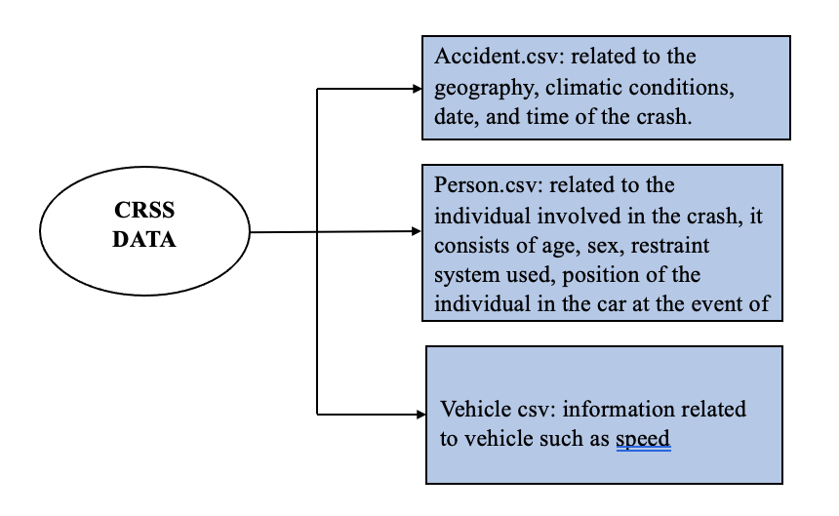
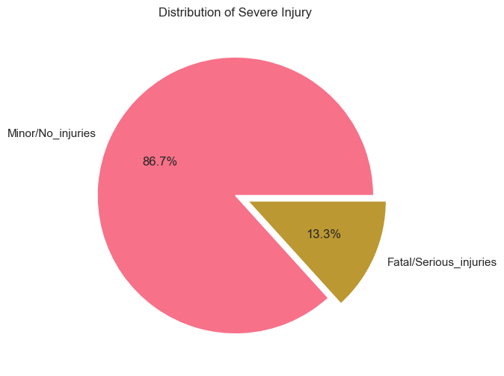
Data Description and Engineering
Which CRSS data files used to create the data set
What is the main challenge in modeling?
Imbalanced Data
Label 1 is only 13.3% of the data

Slide 9
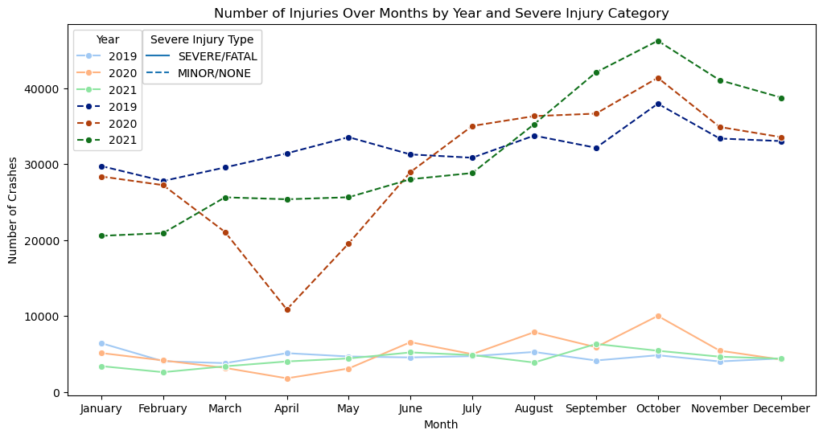
How is Injury Severity Frequency

Slide 10
Major Finding from Data Engineering
Data is imbalanced:
Only 13.3% of the data represent fatal/serious (label 1).
A hypothetical model classifying all cases as Minor/no injury could achieve 86.7% accuracy.
What Techniques to use to tackle the issue
Upsampling with SMOTE
resulted in computational challenges (very big data set size).
Downsampling was identified as the remedy for imbalanced data.
Other findings
April 2020 recorded the lowest number of crashes in each category.
October experienced the highest frequency of crashes.
October 2019 had the most major/fatal injuries.
October 2021 had the most minor/no injuries.

Slide 11
Outline
Background and Research Questions
Methodology of Research
Data Description and Engineering
Visualization
Modeling
Results (e.g., data analysis, modeling results, etc.)
Conclusions

Slide 12
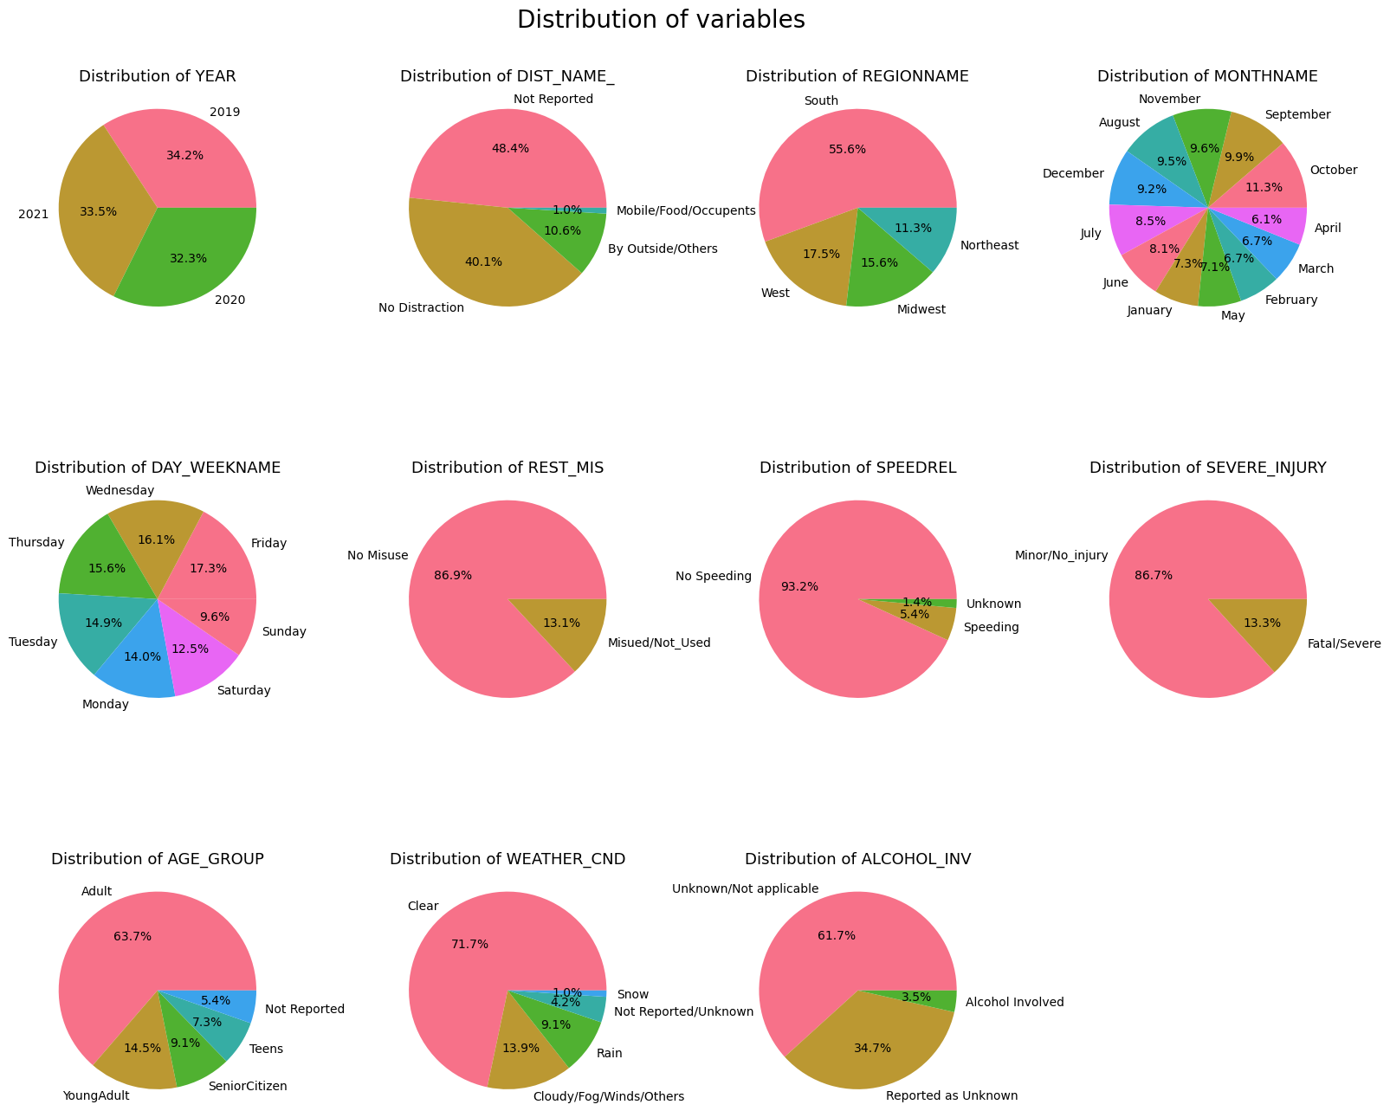
Data Visualization
a) Distribution of factors

Slide 13
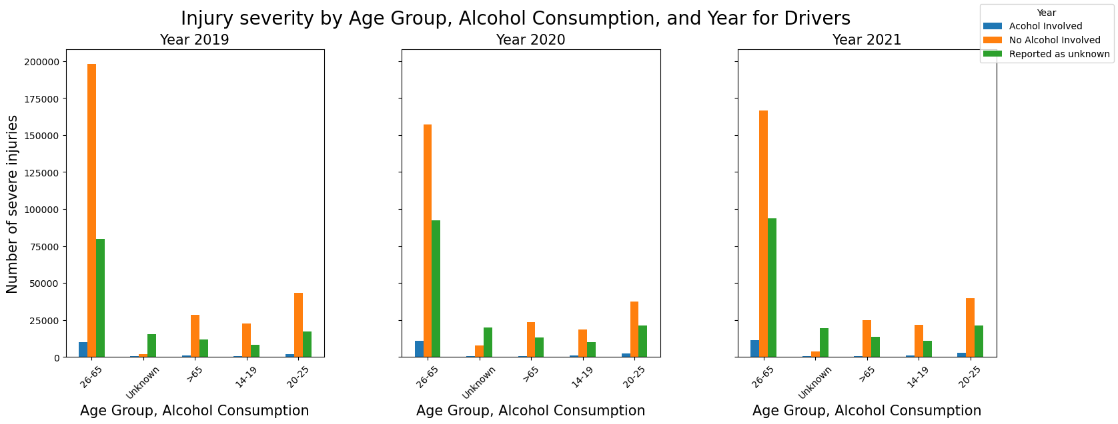
Data Visualization
Injury severity by age group and alcohol-impaired driving

Slide 14
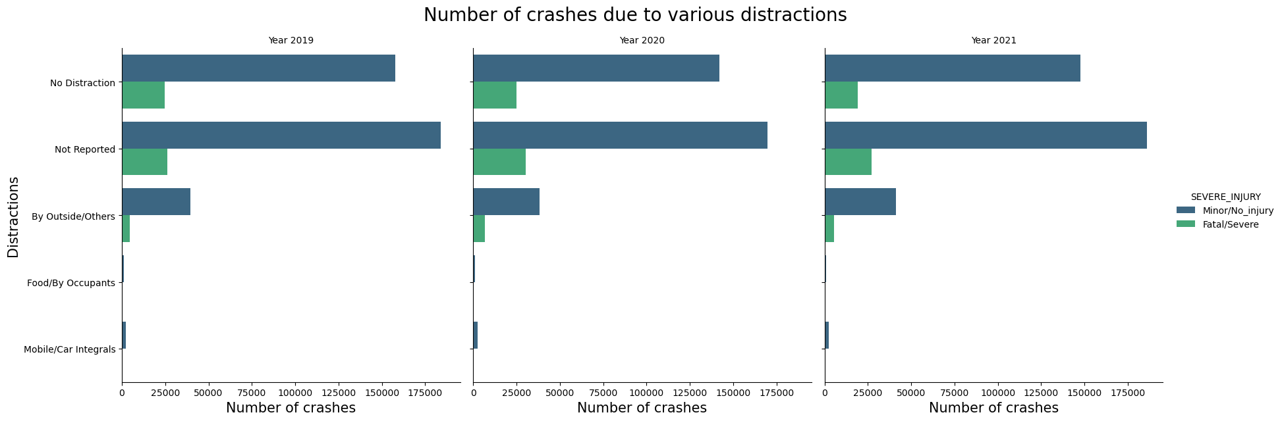
Data Visualization
Distraction categories per year

Slide 15
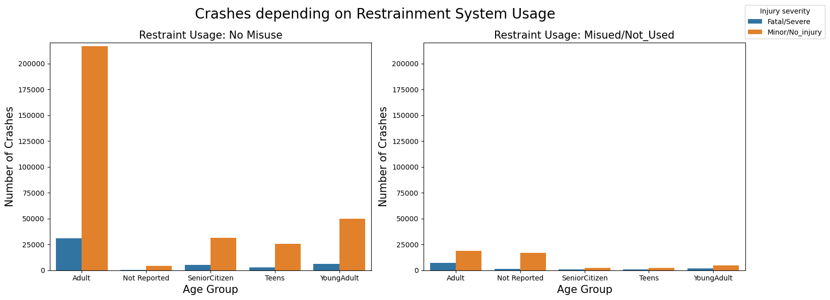
Data Visualization
Seat belt use by age group association with crash

Slide 16
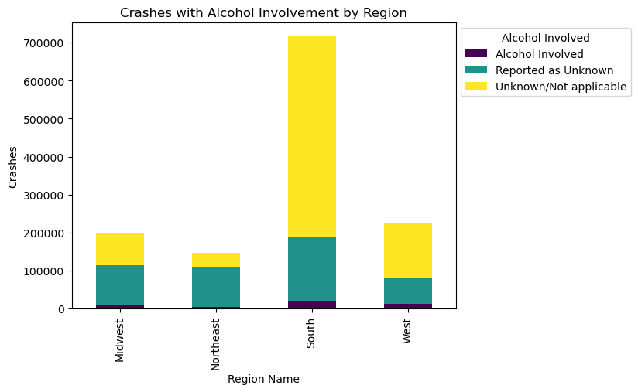
Data Visualization
Alcohol impaired by region association with crash

Slide 17
Outline
Background and Research Questions
Methodology of Research
Data Description and Engineering
Visualization
Modeling
Results (e.g., data analysis, modeling results, etc.)
Conclusions

Slide 18
Modeling
Two binary classification modeling
Logistic Regression
Random Forest
What Metric to use for comparison
Accuracy, Precision, Recall, F-1 score
Modeling Challenge
Downsampling can enhance the precision and recall of the model, however:
Downsampling can lead to a loss of information.
Reducing the size of the majority class affects the overall accuracy of the model.
Comparison of sampling rate vs accuracy is critical to decide the best model.

Slide 19
Outline
Background and Research Questions
Methodology of Research
Data Description and Engineering
Visualization
Modeling
Results
Conclusions

Slide 20
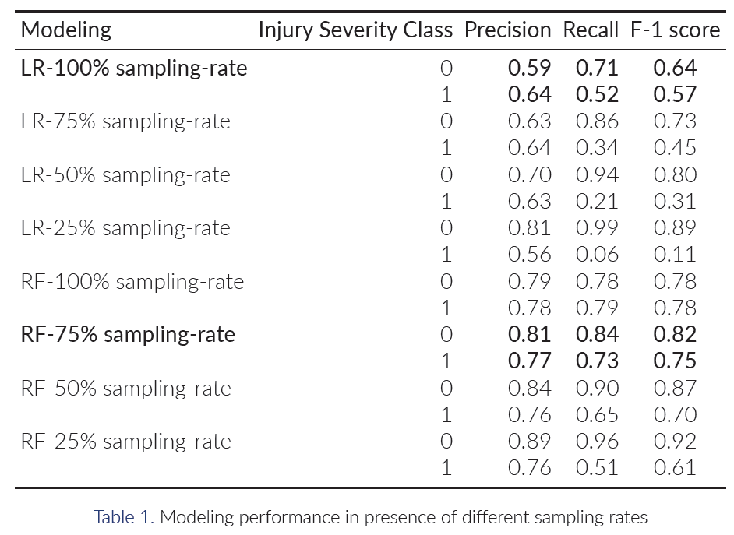
Modeling Results
Trade off analysis of downsampling vs model performance

Slide 21
Outline
Background and Research Questions
Methodology of Research
Data Description and Engineering
Visualization
Modeling
Results
Conclusions

Slide 22
Conclusion: Summary of Findings
Random forest exceeds the modeling performance of LR.
Random forest with 75% sampling-rate resulted in the best performance (with an accuracy of 0.79).
Logistic Regression with 100% sampling-rate performs the best among LR cases (with an accuracy of 0.61).
This analysis showed that the South region experienced the highest number of alcohol-involved crashes.
West region reported the second highest.
Distraction by Outside/Others is the main category of known distraction contributing to both minor and major/fatal crashes.
This category caused the highest fatalities in 2020.
Speeding Contributed to the increasing trend in crashes over the recent years
Future work
Non-linear models appear to be more suitable for prediction
More sophisticated non-linear model consideration to improve all metrics

Slide 23
Thank you

